Slide 1
BARAKA PACK JORDAN ; LTD
GM : MR.ABD ALKAREEM

Slide 2
Company Background Information
Company Name : Baraka Pack Jordan LTD;
Business Address : Jordan, Irbid, P.O.Box:88-21467 , Al Hasan Industrial Zone
Telephone No. : +96227550050
Fax No. : +96227550053
Tel. Office: +96225371288
Date of Incorporation: 2013
Director: MR. ABD ALKAREEM AL-TAKI

Slide 3
Company Background Information
Company Registration No.
Nature of Business : Manufacture and printing of
corrugated carton box
Production Area : 6000 Square Meter
Yearly Turnover: 20,000 Ton
Website : www.barakapack.com
Email : Info@barakapack.com

Slide 4
Company Background
Baraka Pack Company was founded at 2013 in Jordan ( Al-Hassan Industrial Zone ).
Business owners have good experience in this domain and they have a trading company in the field of raw materials for paper, where the papers is considered a key factor in the success of this industry.
This plant has a production line with the latest technology , in addition to distinctive Print on all paper types, and the production capacity for our plant very large can to accommodate the large quantity of orders confirming to customer requirement

Slide 5
Vision & Business Concept
Baraka upholds a concerted effort in delivering heights quality of customer services and products, that contribute to the company’s objectives.
Baraka business concept encompasses the maximization of resource utilization and productivity

Slide 6
Objectives
Baraka pack strives to attain the company’s goals by :
1- Achieving total customer satisfaction in quality competitive price, delivery, and services.
2- Continuously improving our quality, efficiency and effectiveness.
3- Evaluating the quality management system (QMS) compliance & achievement thru periodical quality objective measurement and management review.

Slide 7
Major Customer
1- Prosperity International Factory
2- Century Miracle
3- Al-Durra for General Trading and Investment Co.LTD
4- Halawani Industrial Company
5- Al-Rayan for Plast Ind.Co
6- The Arab Pesticides & Veterinary Drugs Mfg. Co.
7- NewPack for Packing
8- Arabian Group of Companies
9- Jordan Elaf Adhesive Industry, Co..
10- Ramco Electricals Company
11- Classic Fashion Apparel Industry
12- Standard Textile – Jordan

Slide 8
Quality Policy
Baraka Pack committed to being an efficient and customer preferred corrugated carton boxes supplier by actively pursuing the following:
1- Achieving total customer satisfaction in quality competitive price delivery and services (QCDS)
2- Continuously improving our quality, efficiency and effectiveness.
3- Evaluating our quality management system (QMS) compliance and achievement periodical quality objectives measurements and management review.

Slide 9
Process Flow Chart
Incoming material
inspection
Printing Flexo
3 Colour Printing
Creasing
Scoror
Printing Flexo
4 colour Printing
Creasing
Scoror
Various Converting Machine
Pad
Lamination
Inspection
Inspection
Inspection
Die Cut
Inspection
Slotter/Scorre
Gluing/Stiching
Inspection
Tying /Packing
Delivery

Slide 10
ORGANIZATION CHART
General Manager
Sales Manager
Finance Manager
Production Manager
HR Manager
Maintenance Manager
IT Manager
Salesperson
Salesperson
Marketing Planning
Customer
General
Cost
QA/QC
Planning, Organize & Review
Control & monitoring
IT Assistant
QC Inspector
HR Office
Maintenance Assistant
Customer Service Coordinator/Purchasing Coordinator/ Art Work
Account Assistant
Production Supervisor
Production Assistant
Leader
Store Keeper
Office Assistant
Operator
Driver

Slide 11
Machineries & Transport
List of our machineries are as follows:-
No | Machine Name | Unit | Capacity
1 | 4 Colours China Flexo | 1 | 15000/M 10
2 | 3 Colours Printing Flexo | 1 | 10000/M
3 | Die cutter Automatic | 1 | 10000/M
4 | Auto Gluer Machine | 1 | 15000/M
5 | Auto Sticher | 1 | 10000/M
6 | Production Line | 1 | 200/MM

Slide 12
Inspection
Quality Control Department
We perform inspection for every production process and quality of products are maintained with our customer requirements:
A- Incoming Inspection
We perform the incoming inspection for all batches of materials will be received and used in the production and not affecting the products quality.
B- In-Process inspection
we care the quality of products by performing in-process inspection to ensure quality meet the customer requirements
C- Out-going Inspection
We focused on customer satisfaction we perform out-going quality inspection to insure the quality all the goods delivered to customer are confirming to the requirements

Slide 13
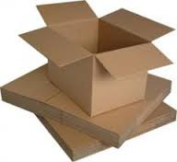
Regular Slotted Carton (RSC)

Slide 14
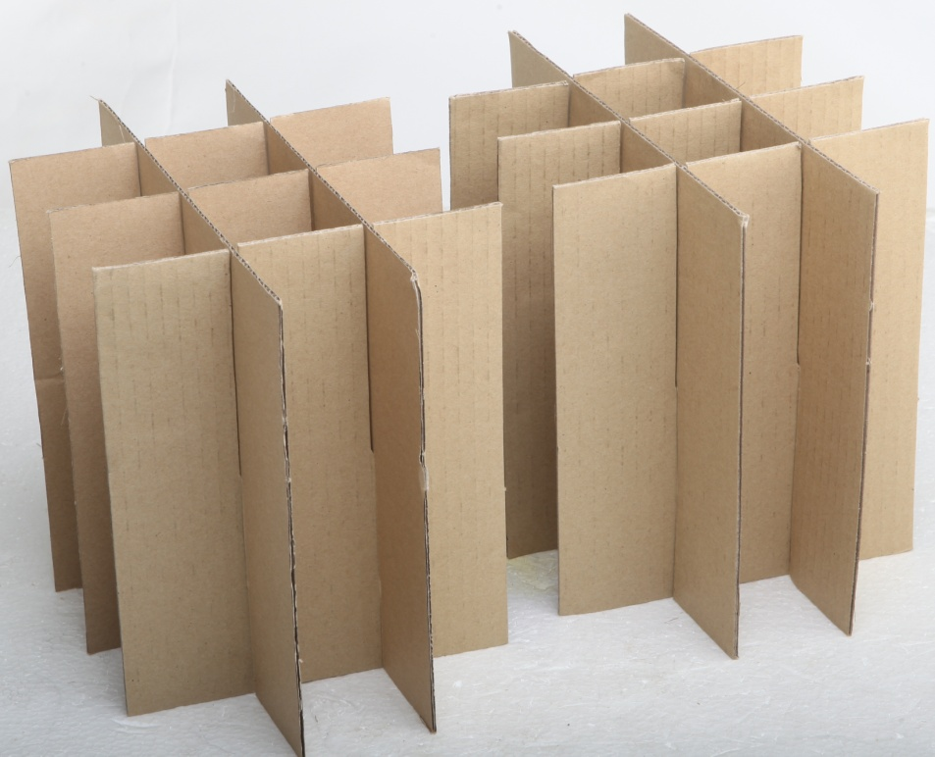
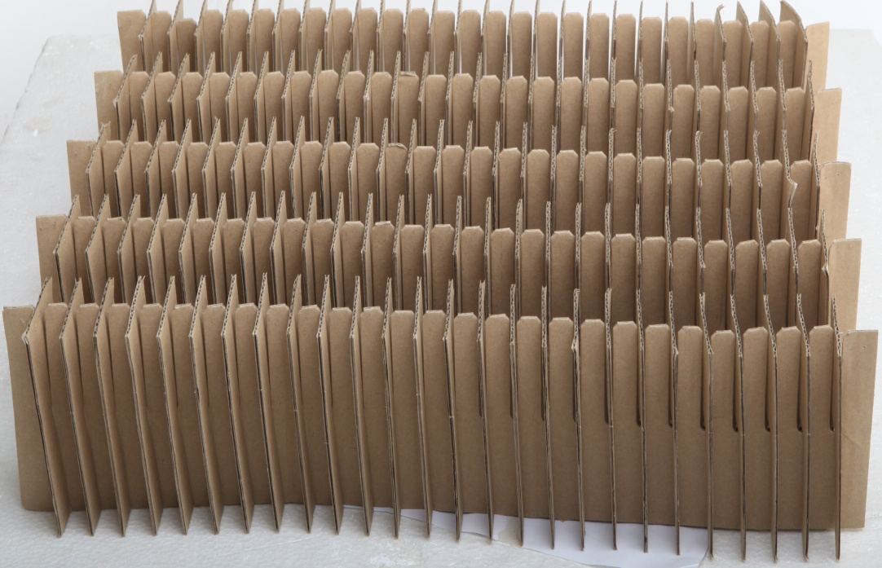
Nesting

Slide 15
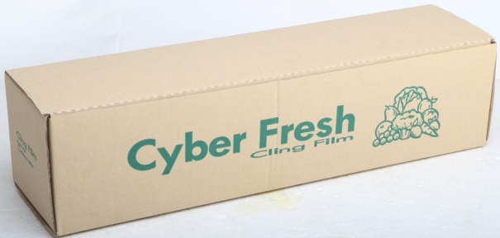
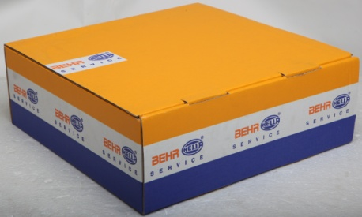
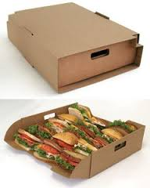
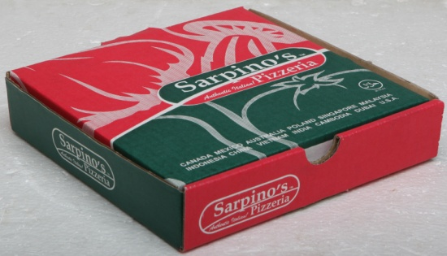
Diecut Products

Slide 16
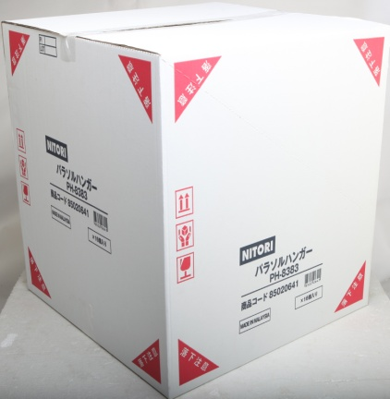
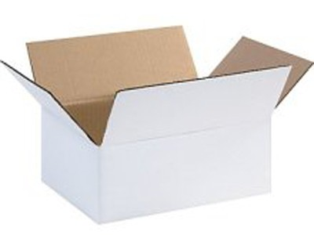
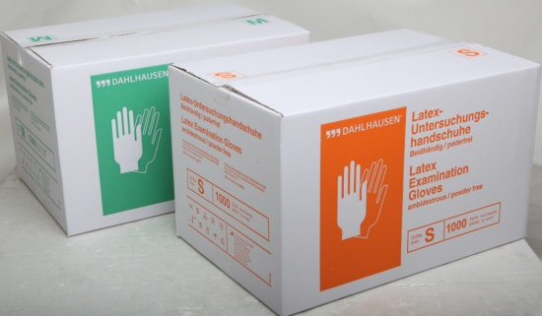
White Paper Board

Slide 17
Thank You Eng. Manal

